Slide 1

MYLEGION OVERVIEW:
My Account
Membership details, update contact and demographic information, print membership card, and manage user account.
2025
Notes:
Register a MyLegion account to review and manage membership details.

Slide 2
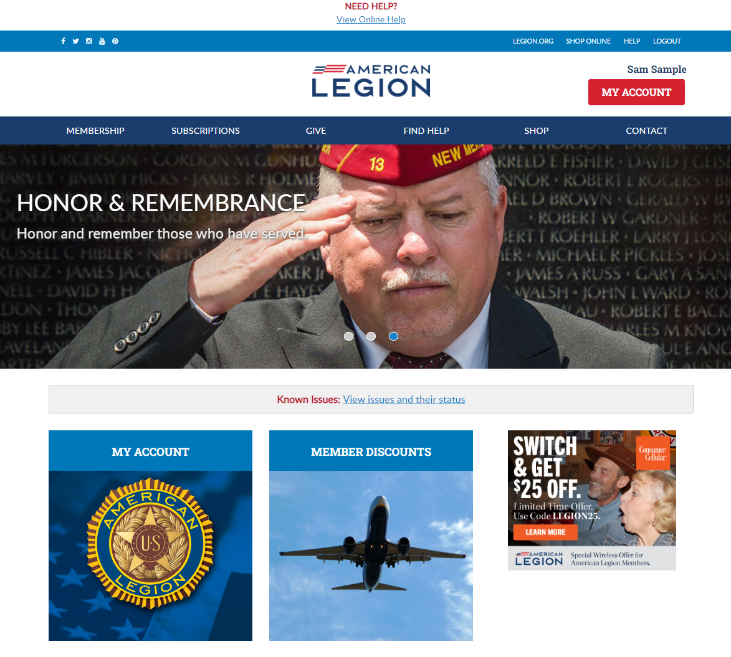
Notes:
Successful registration opens the MyLegion Home page that displays your name.
To view membership details and manage your account click on My Account. <1>
Leadership seeking post and squadron membership will access that information through My Account.

Slide 3
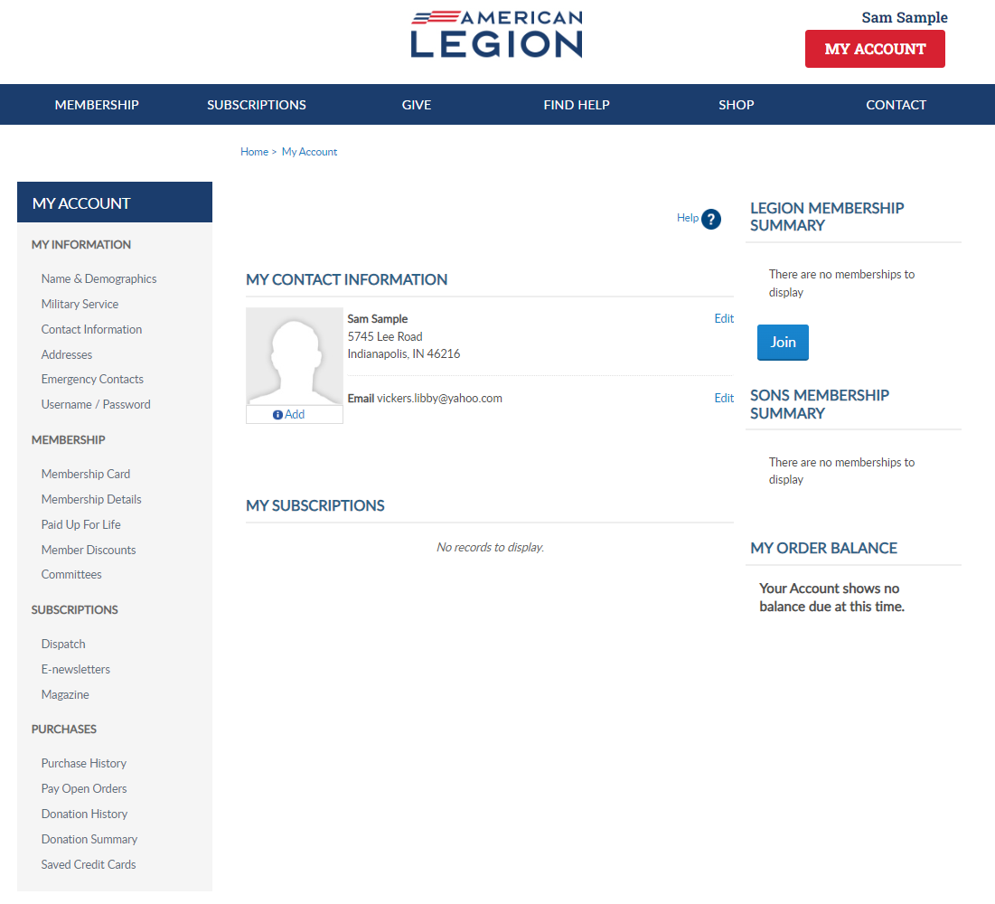
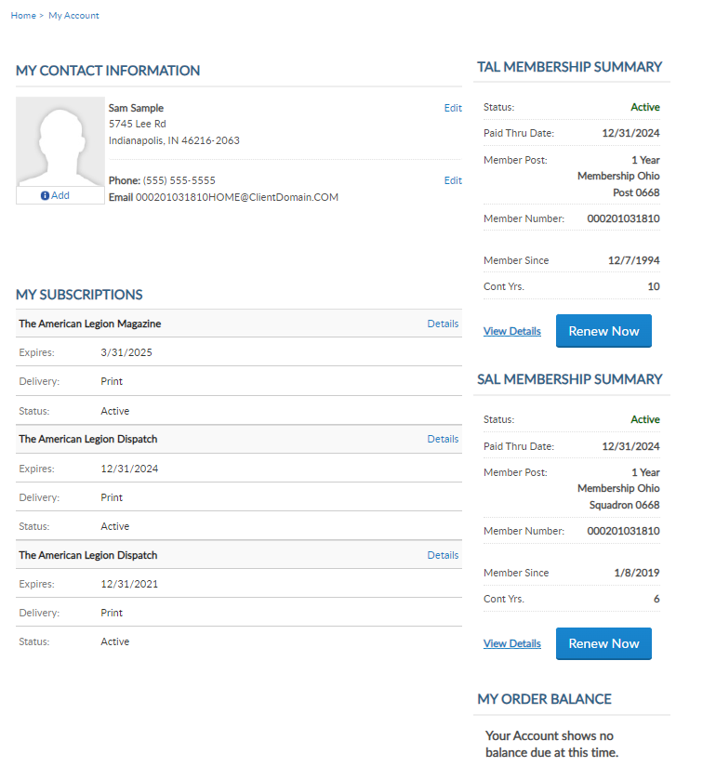
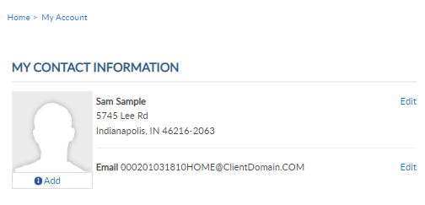
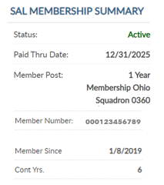
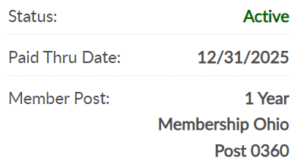
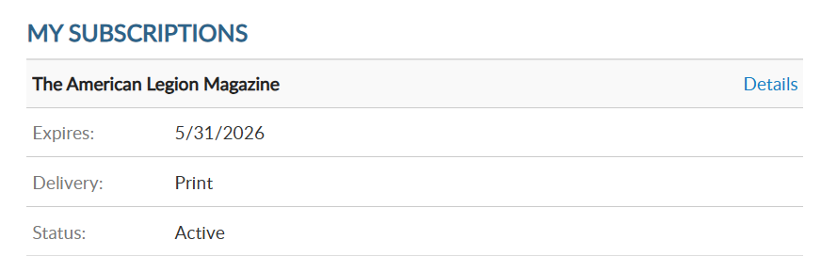

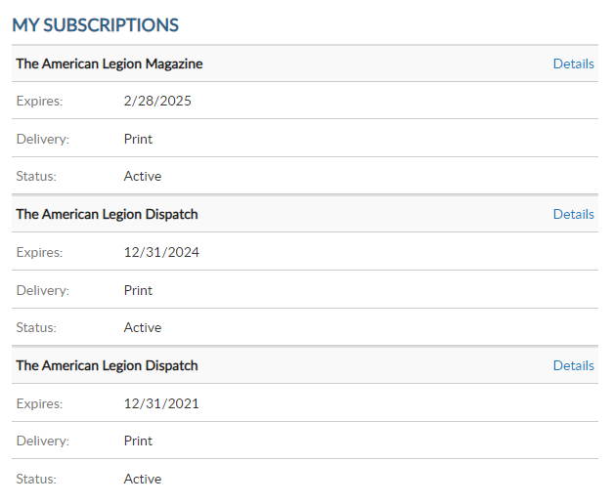
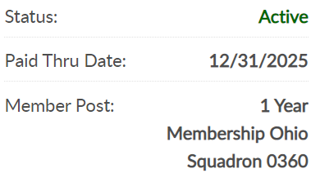

000123456789
PrimaryEmailAddress.com
000123456789
Notes:
My Account provides information on file at Department and National Headquarters.
Members of both Legion and SAL, also known as dual members, will have the same membership ID#. <1>
The membership summary also includes status, paid through date, renewal type, join date, and continuous years.

Slide 4
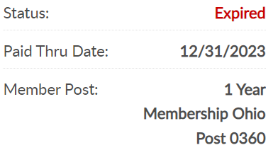
  Membership year is Jan 1 through Dec 31
  Renewal available July 1
  Active Status - paid for current membership year.
  Expired Status – Members not renewed for current membership year after Jan 31.
  Online Renewal - Learn more about member online renew in Find Help.
000123456789
PrimaryEmailAddress.com
12/31/2024
000123456789
Notes:
The American Legion and Sons of the American Legion Membership year runs from January 1 to December 31. The renewal campaign begins July 1 for the next membership year.
Members paid for the current membership year display Active status.
<1> Expired status are members who have not renewed for the current membership year, after the grace period. Members in grace and expired status will have a Renew Now button to renew membership.

Slide 5
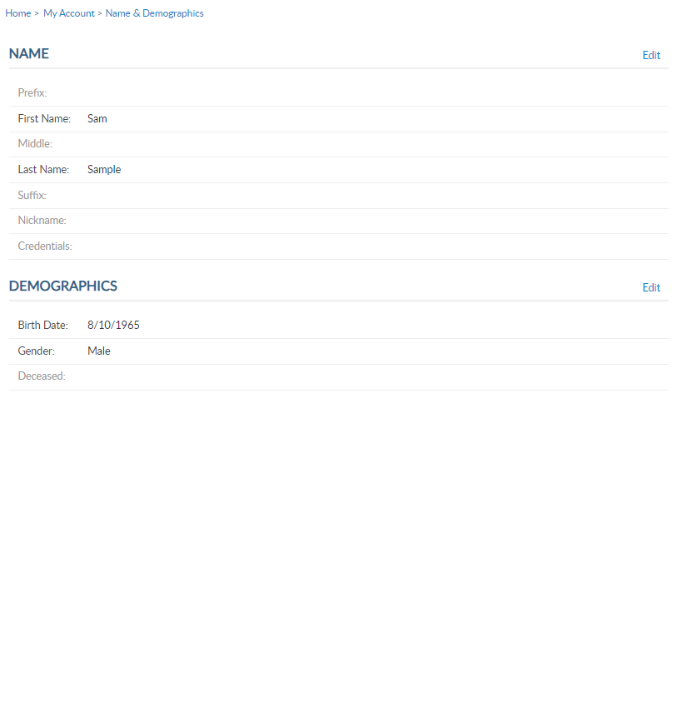
Notes:
MyLegion allows you to manage your name and demographic information. From the left menu, select Name & Demographics to open the edit window. <1>
There are 2 sections in this area. Each has an Edit option. The name section includes prefixes, suffixes, nickname and title information. Click edit to make updates. <2>

Slide 6
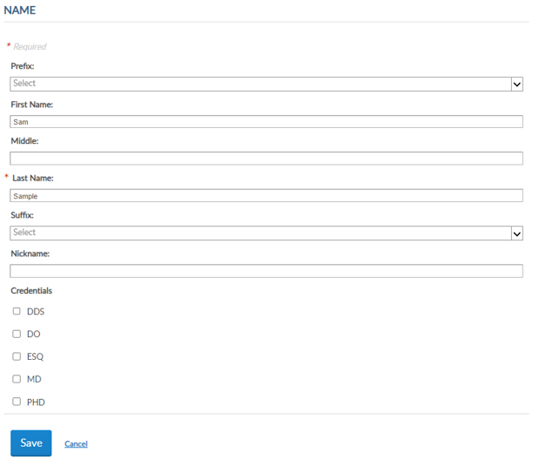
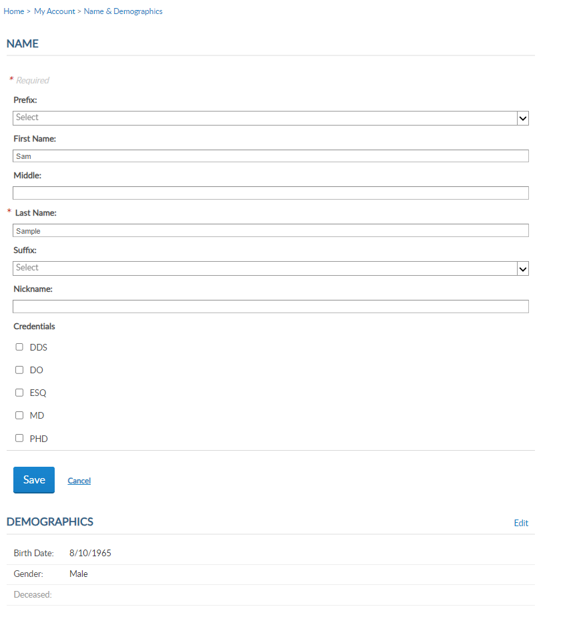
Notes:
Drop down menus will display available prefixes and suffixes. Click Save once the updates have been made. <1>

Slide 7
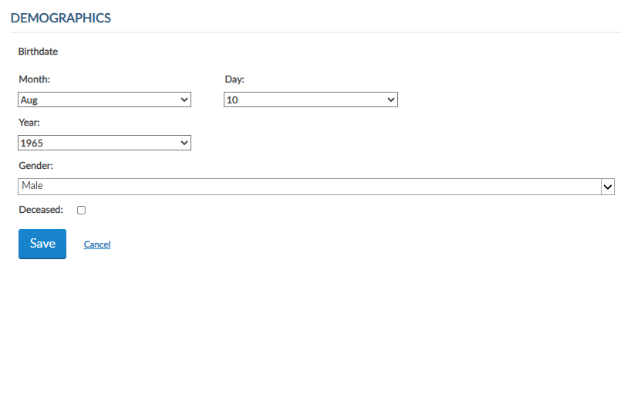
Notes:
The demographics section includes date of birth, gender and deceased status. Click Edit <1> to make updates for demographics. Update as needed and Save. <2>

Slide 8
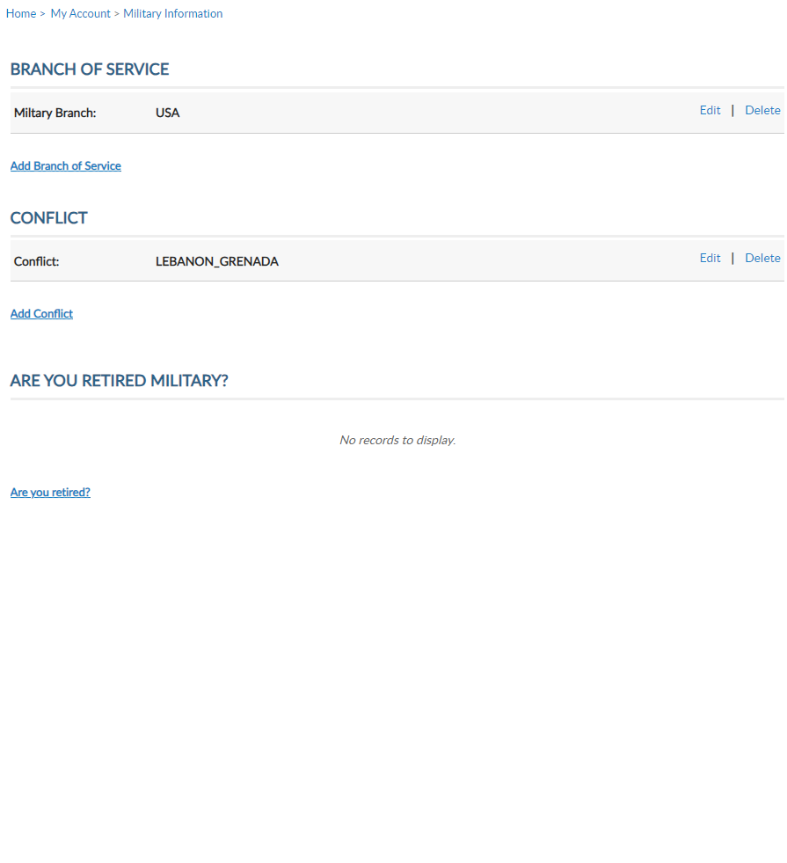
Notes:
Military service provides branch of service, conflict and retirement information for Legion membership. Using the Add, Edit or Delete links you can manage this information. Members who have served in multiple conflicts or armed forces can add to their profile using Add links. SAL members are not required to list branch of service or conflict.

Slide 9
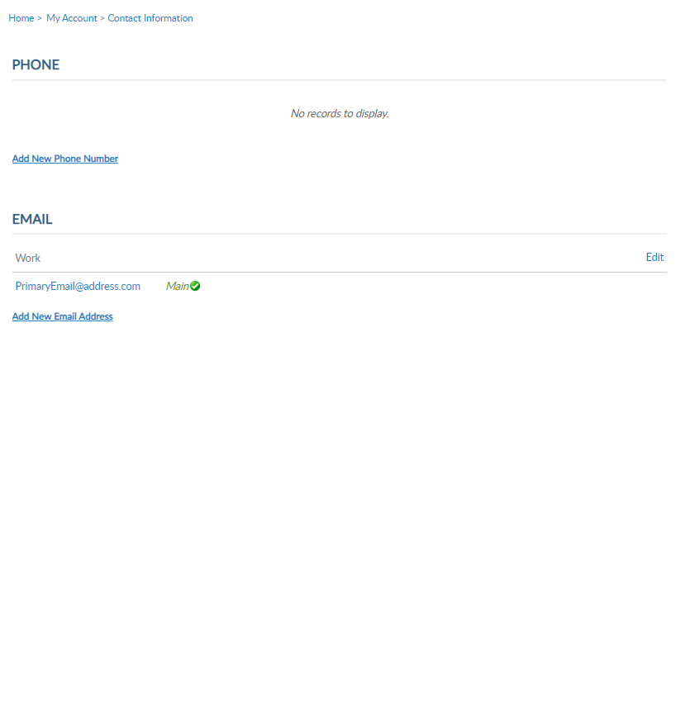
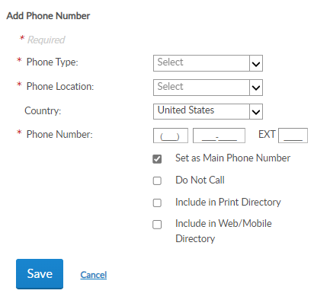
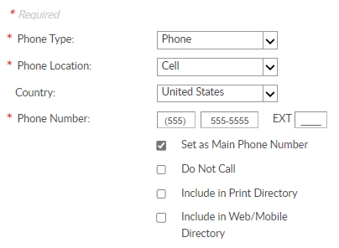
Notes:
Contact information includes phone number and email. Only one main contact is available. You can have alternate phone numbers and email address on your membership record. These can be used for online subscriptions and committee assignments. Main contact information is listed on the post or squadron membership roster. Let’s add a phone number. Click on <1> Add New Phone Number.
<1> Select phone type, location and number. If only one number is on file, it will be set as your main phone number. Click <2> Save when finished.

Slide 11

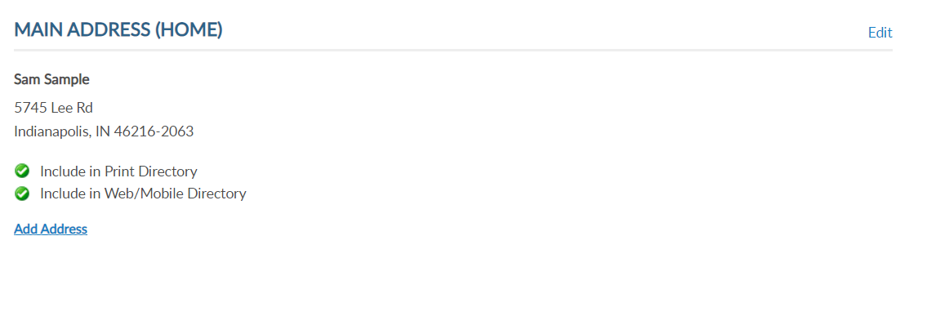
Notes:
The phone number displays in My Contact Information.
<1> Addresses allows you to add an alternate address and set address preferences. Information set as Main is the primary contact information.
Only one main contact can be on file. Adding an address with the Main Address preference will replace the existing main address.

Slide 12

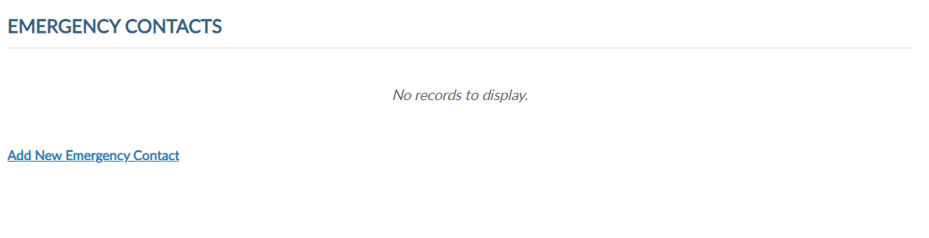
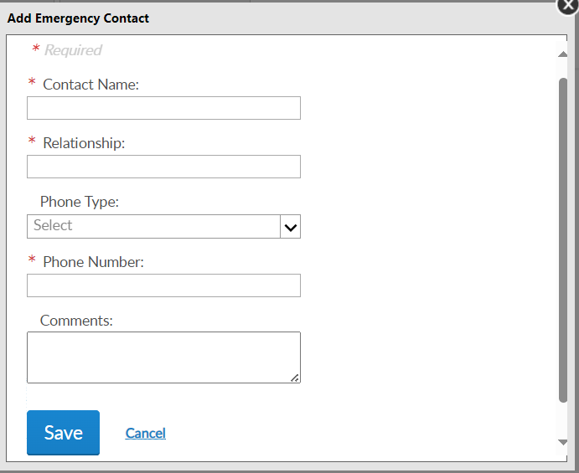
Notes:
Emergency contact information can be useful in case of an emergency if you are attending a convention, event, or at your local post or squadron.
Add a single contact or multiple contact and designate the priority of who to contact via phone. <1> Click “Add New Emergency Contact”, enter data and “Save.”

Slide 13
000123456789
PrimaryEmailAddress.com
000123456789
Notes:
Username/Password allows users to update log in credentials. This link opens a self-service window that shows your current username and primary email associated with your account.

Slide 14
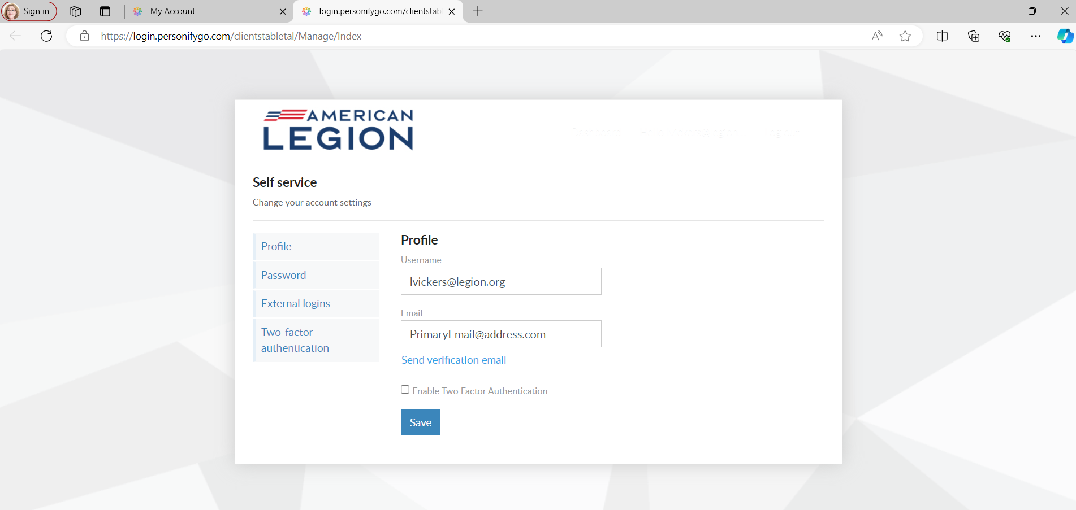
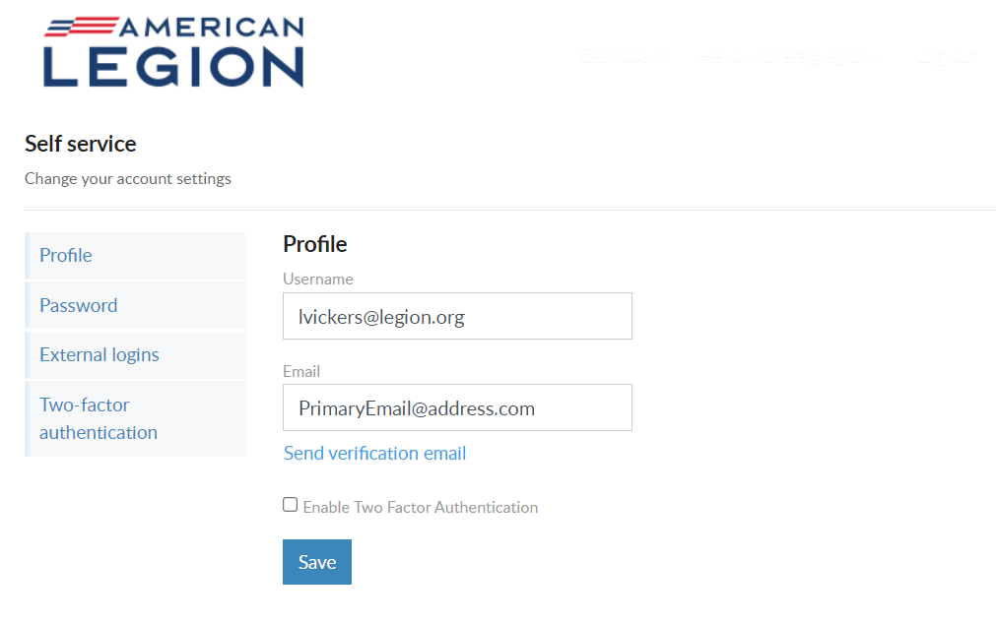
Notes:
Notice a new tab opens in your browser. When complete with reviewing or updating information, close the tab to return to your MyLegion account.
Your account profile includes username and primary email address. MyLegion accounts are associated with the primary email address on file. Your username does not have to be an email address but is recommended. The email address listed in the self-service window is the primary email. Updating the email in Username/Password directs all future forgot username and passwords to this email.
Enter new information and Save.

Slide 15
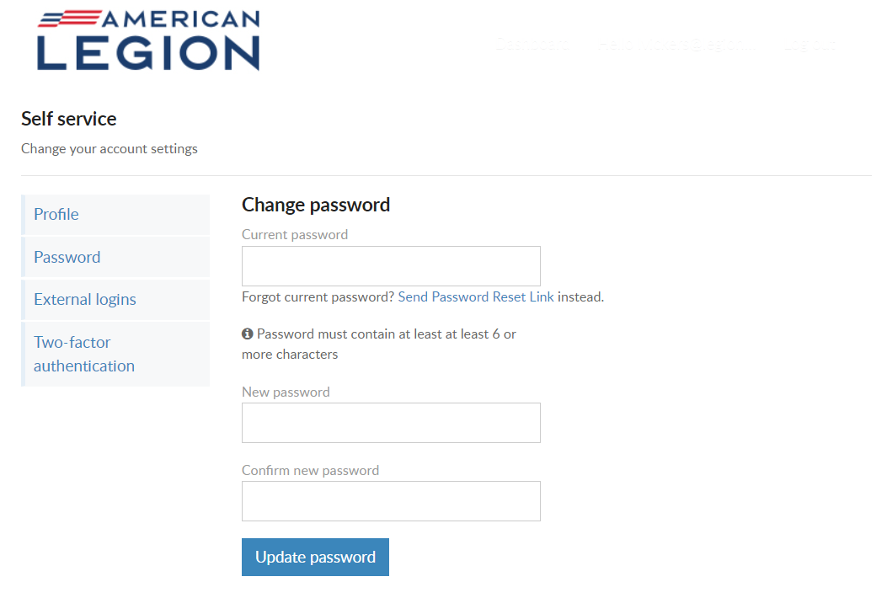
Notes:
To update your password in the self-service window you must know your current password. If you have logged in with a saved password and do not know it, you can log out and use the forgot password link on the log in window.
If you have your current password, enter it with the new password and click ‘Update Password’.
<1> Password requirements include: 1 Uppercase letter, 1 Lowercase letter, 1 Number, 1 symbol, and have an eight character minimum.

Slide 16
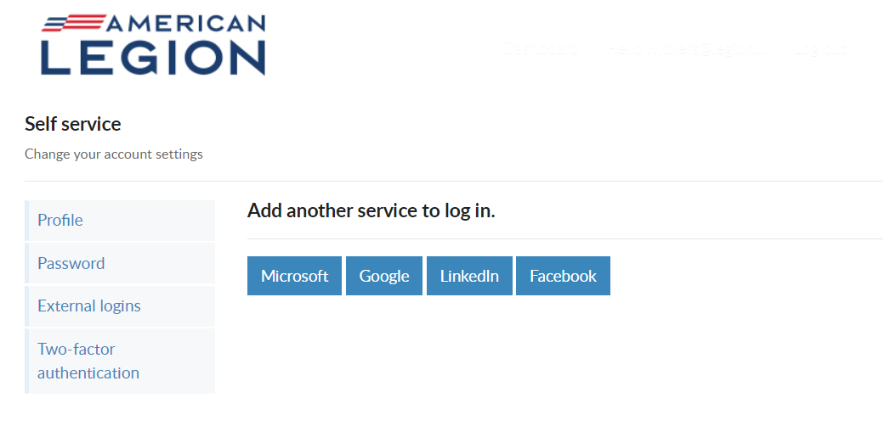
Notes:
Like many other web applications, myLegion users can log in using other online identities as a single sign on process. Allowing fewer passwords to remember.

Slide 17
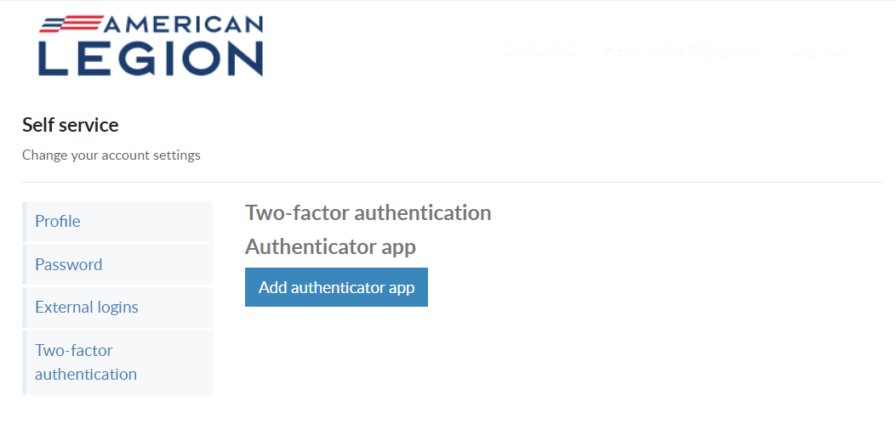
Notes:
Two-factor authentication is an extra layer of security to ensure that you're the only person who can access your account, even if someone knows your password. This extra security measure requires you to verify your identity using a randomized code we'll send you each time you attempt to log in.
If you set up 2 factor authentication, you can disable through self service.

Slide 18
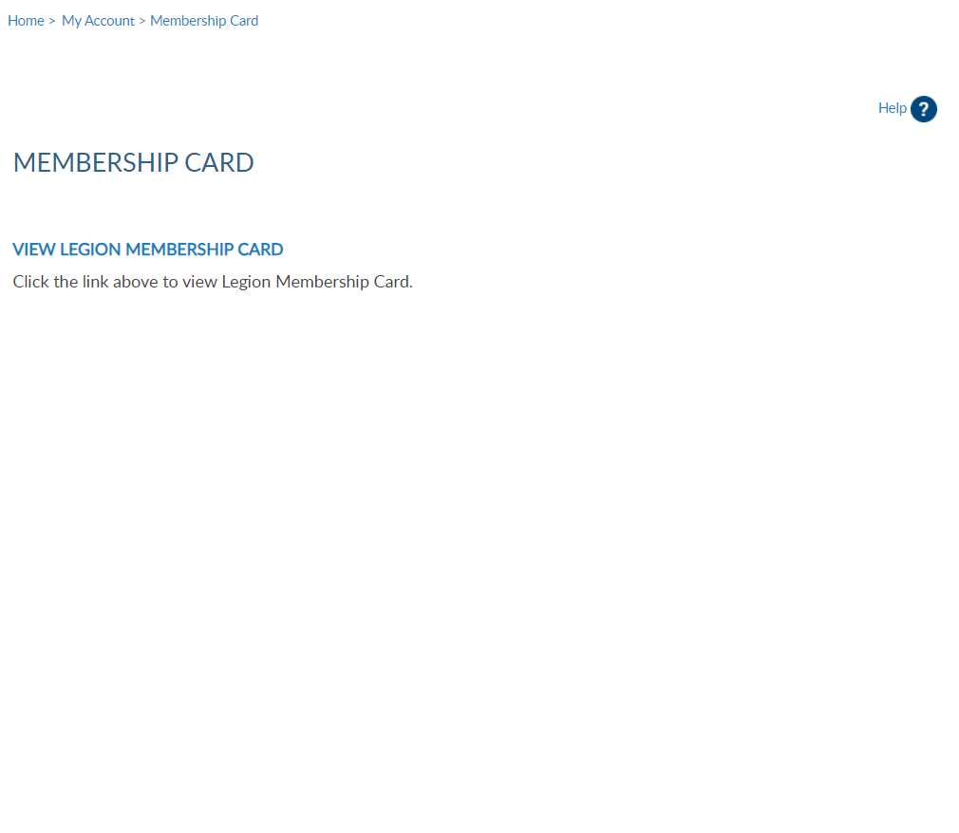
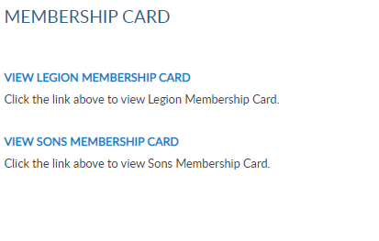

18
4
Notes:
To print your membership card go to Membership Card <1>. Only current membership cards are available. Click the link for the card to print.

Slide 19
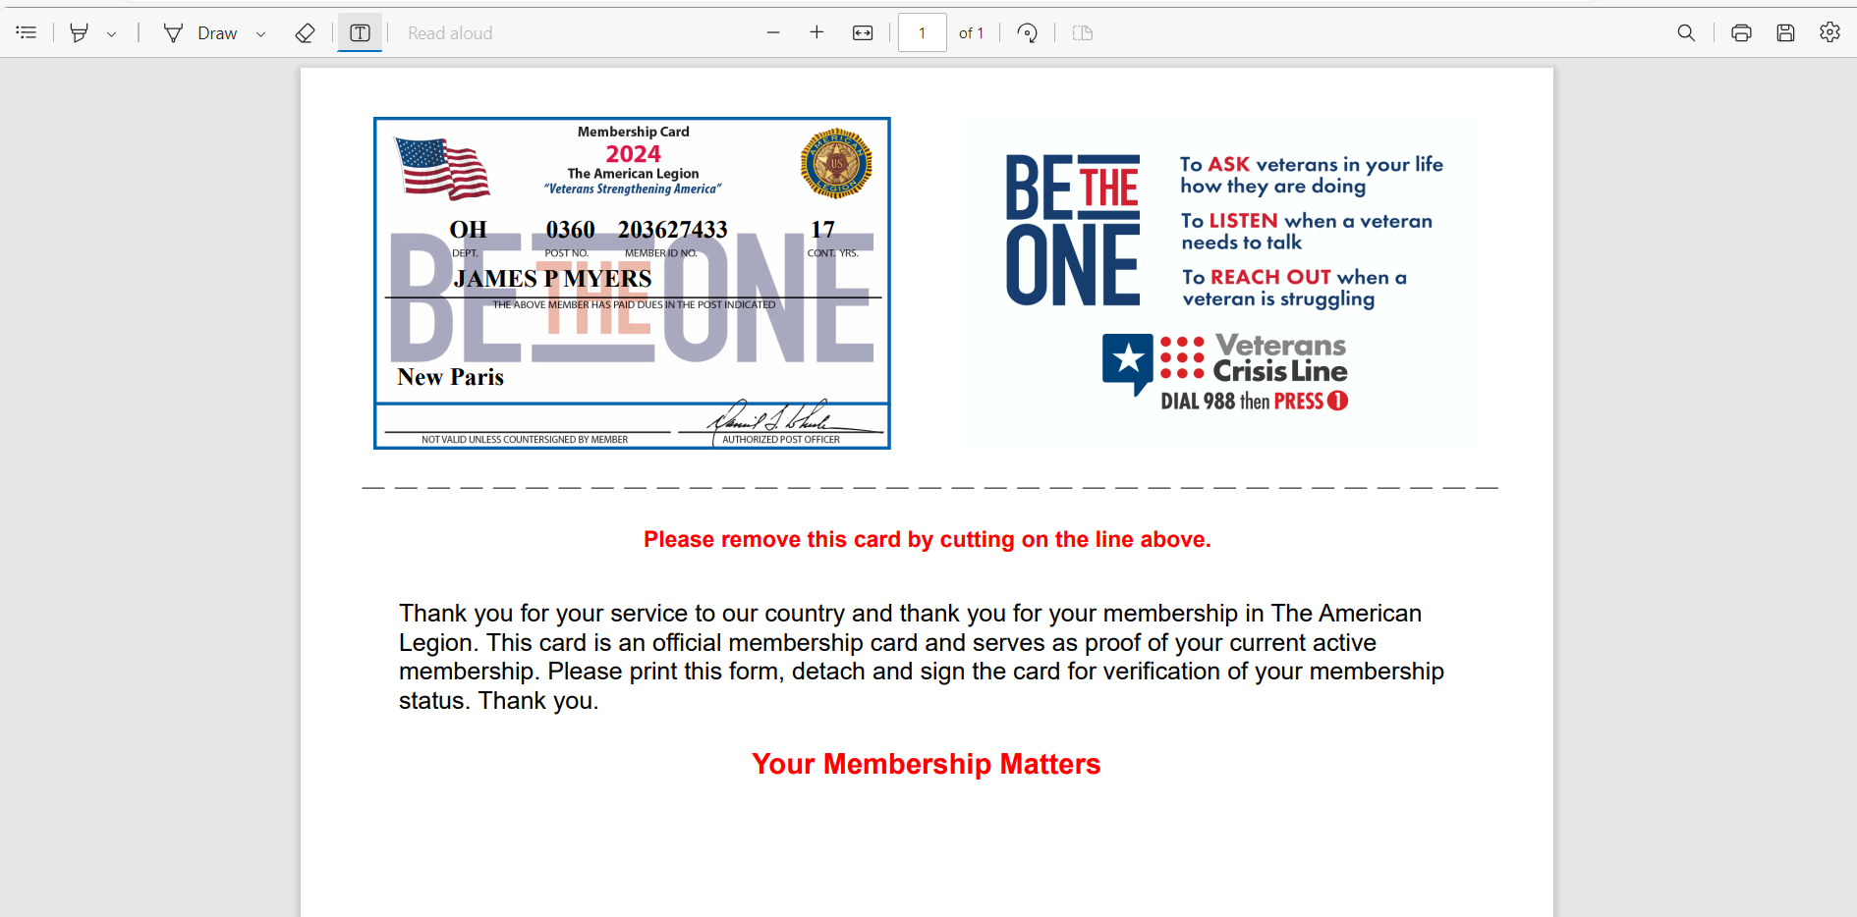
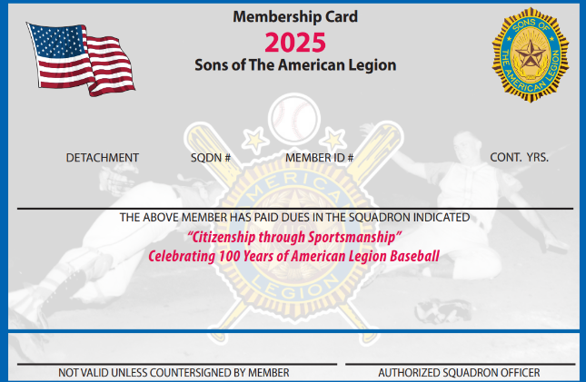
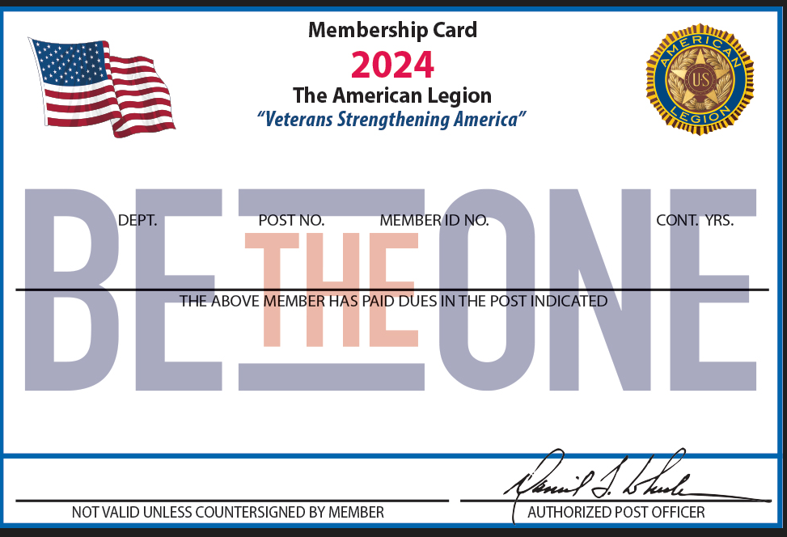
Only current membership cards are available.
OH 0668 123456789 10
SAM SAMPLE
Vadalia
Notes:
The card is available to print or save from your web browser. Both Legion and <1>SAL cards are available.

Slide 20
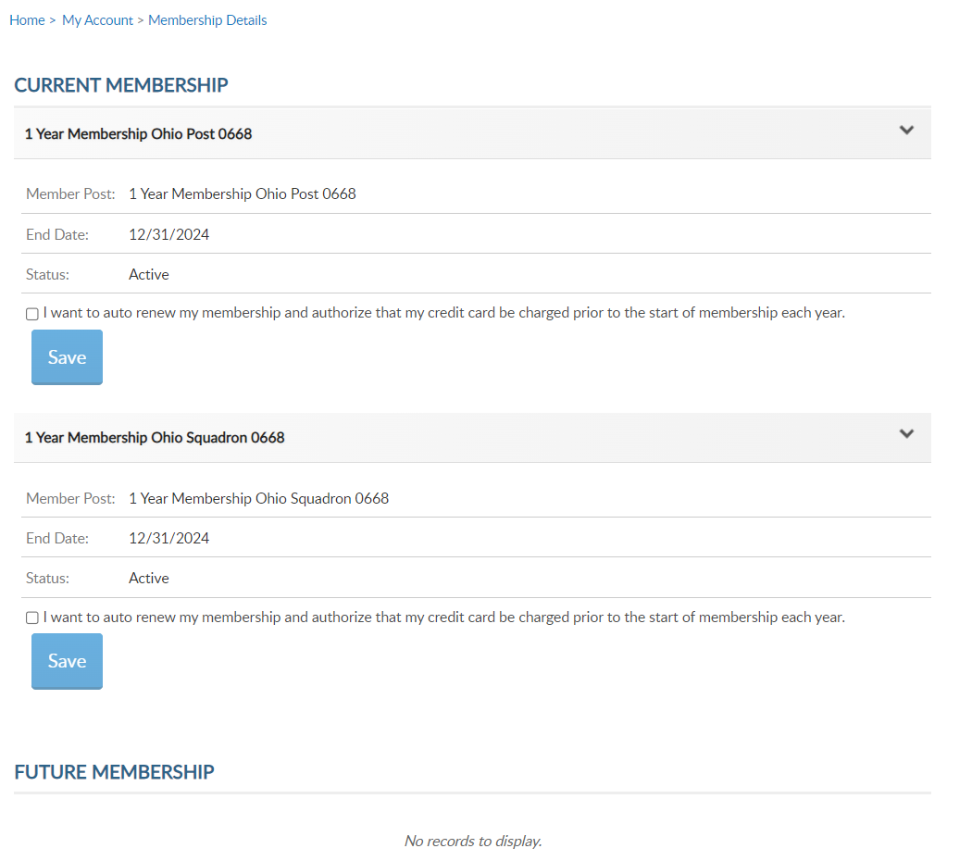
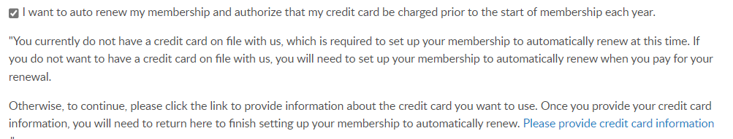
1 Year Membership Ohio Post 0360
Member Post: 1 Year Membership Ohio Post 0360
12/31/2025
1 Year Membership Ohio Squadron 0360
Member Post: 1 Year Membership Ohio Squadron 0360
12/31/2025
Notes:
View membership status and manage automated renewal in Membership Details.
MyLegion allows you to set up auto renewal. Members set up for auto renewal will have their credit cards charged by the 2nd week of July annually and do not receive renewal notices. Auto renew is available for both American Legion and Sons of the American Legion members. You will have to set up each auto renew separate if you are a dual member.
A credit card must be saved prior to setting up auto renew. Credit card information is stored in Saved Credit Cards. <1>

Slide 21
000123456789
PrimaryEmailAddress.com
Legion
Only
000123456789
Notes:
The Paid Up For Life links provide the application to purchase a Legion paid up for life membership. The application provides a quote to purchase or set up a time payment plan. Sons of the American Legion do not have a national life membership program.

Slide 22
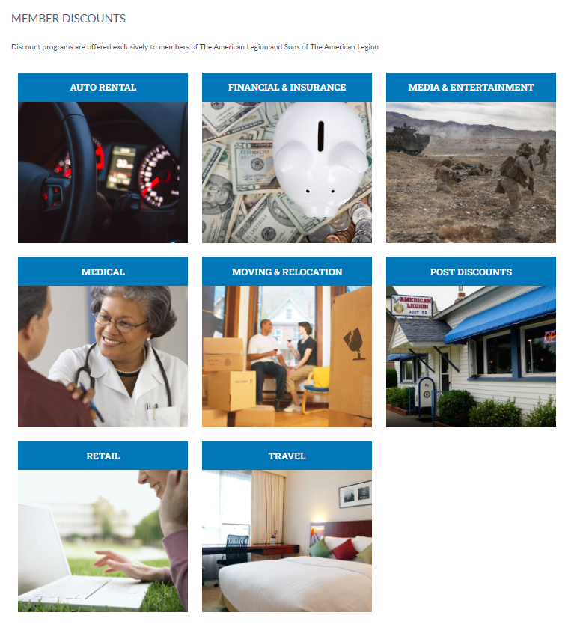
Notes:
The American Legion offers exclusive discount programs for members of The American Legion and Sons of the American Legion. Discount provider information and codes are only available to members.
Discount codes are found only when logged into myLegion or legion.org. Select the area of interest to view provider contact information and exclusive discount codes.

Slide 23
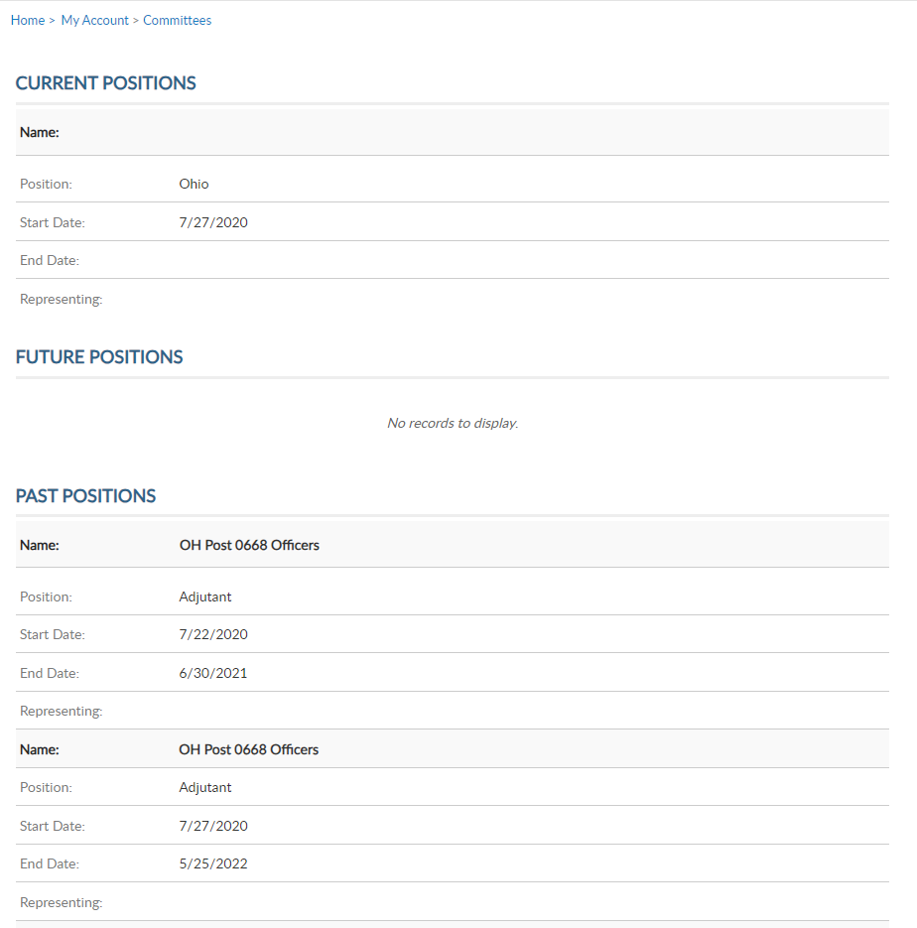
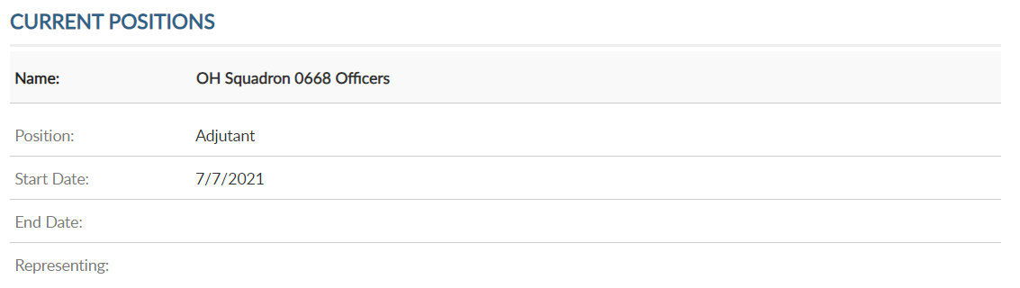
Name: Ohio Squadron 0360
Name: Ohio Squadron 0360
Name: Ohio Post 0360
Notes:
Committees list current, future and past positions reported to national headquarters. Missing information regarding your officer history can be clarified through your department headquarters.

Slide 24
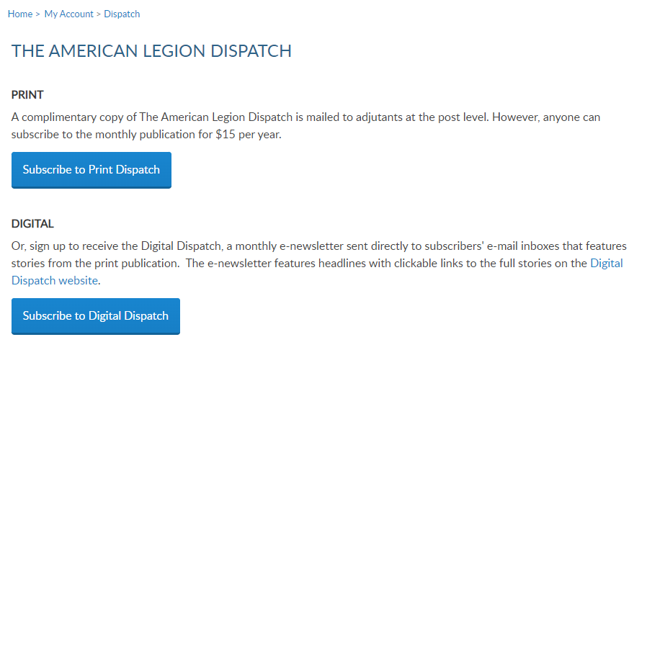
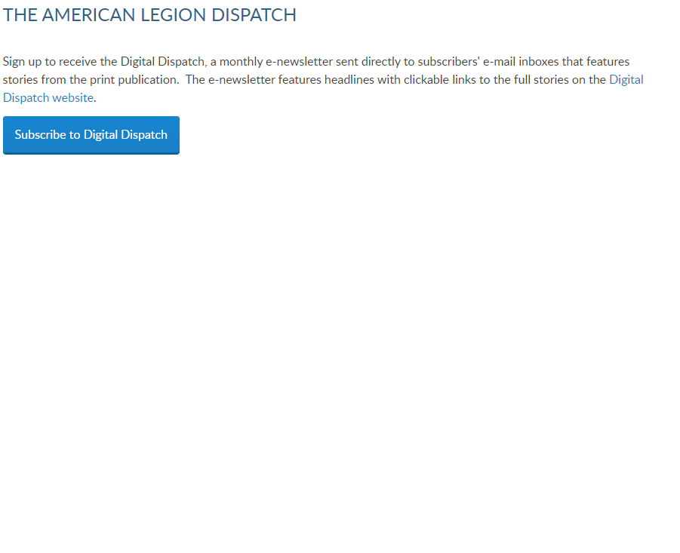
Notes:
Dispatch is an American Legion National Headquarters monthly online newsletter that provides post, district and department leaders with news relevant to membership, post activities and national American Legion news.
A monthly Digital Dispatch e-newsletter is sent directly to subscribers’ email inboxes. The e-newsletter features headlines with clickable links to the full stories on the Digital Dispatch web page, www.legion.org/dispatch.

Slide 25
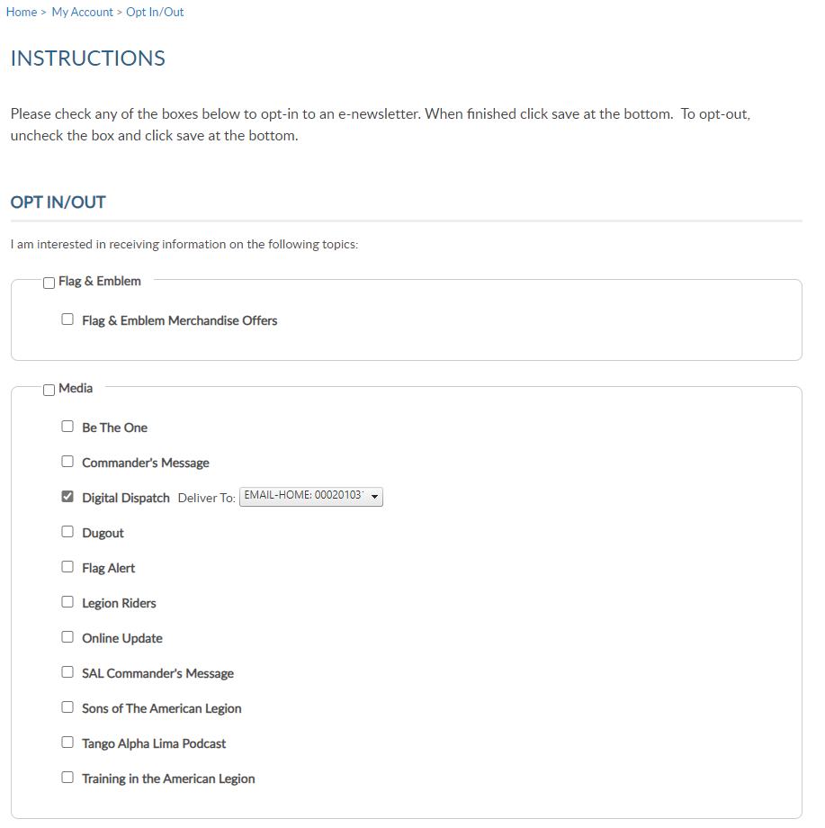
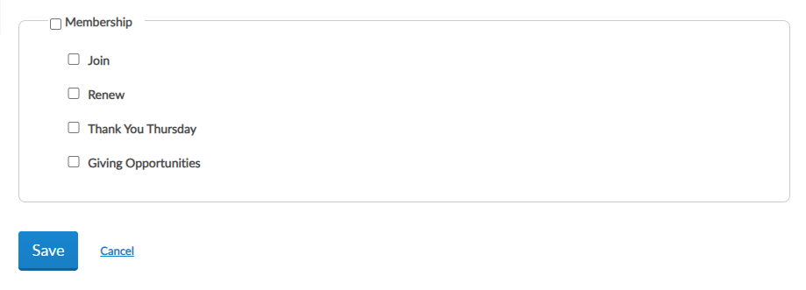
Notes:
E-newsletters allows you to opt in or out of online subscriptions.
Check the box to select individual subscriptions. Unless specified these subscriptions will be emailed to the main email address on file.
Once all options are selected, save changes.

Slide 26
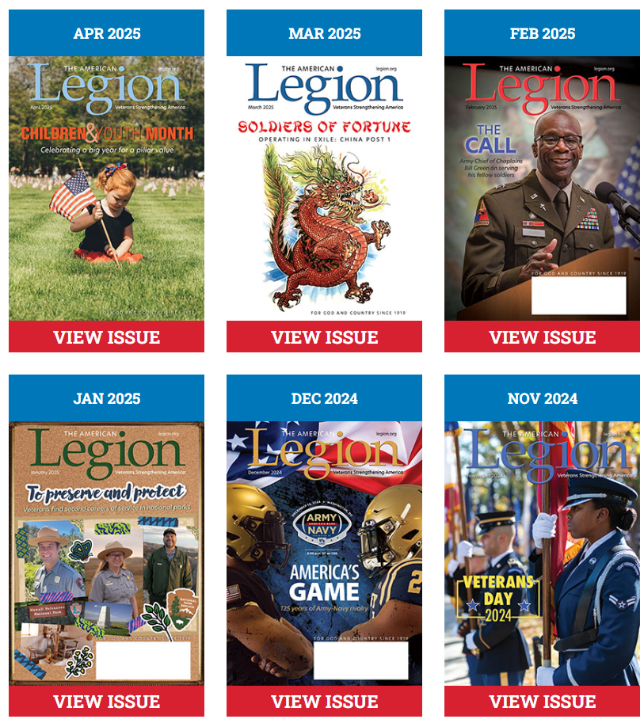
Notes:
American Legion members receive a 12-month free subscription to The American Legion Magazine. This publication has gone digital. Current and past issues are located your My Account subscriptions menu.
SAL and expired members will receive an Access Denied message. Access to online magazine requires active American Legion membership, or paid subscription.

Slide 27
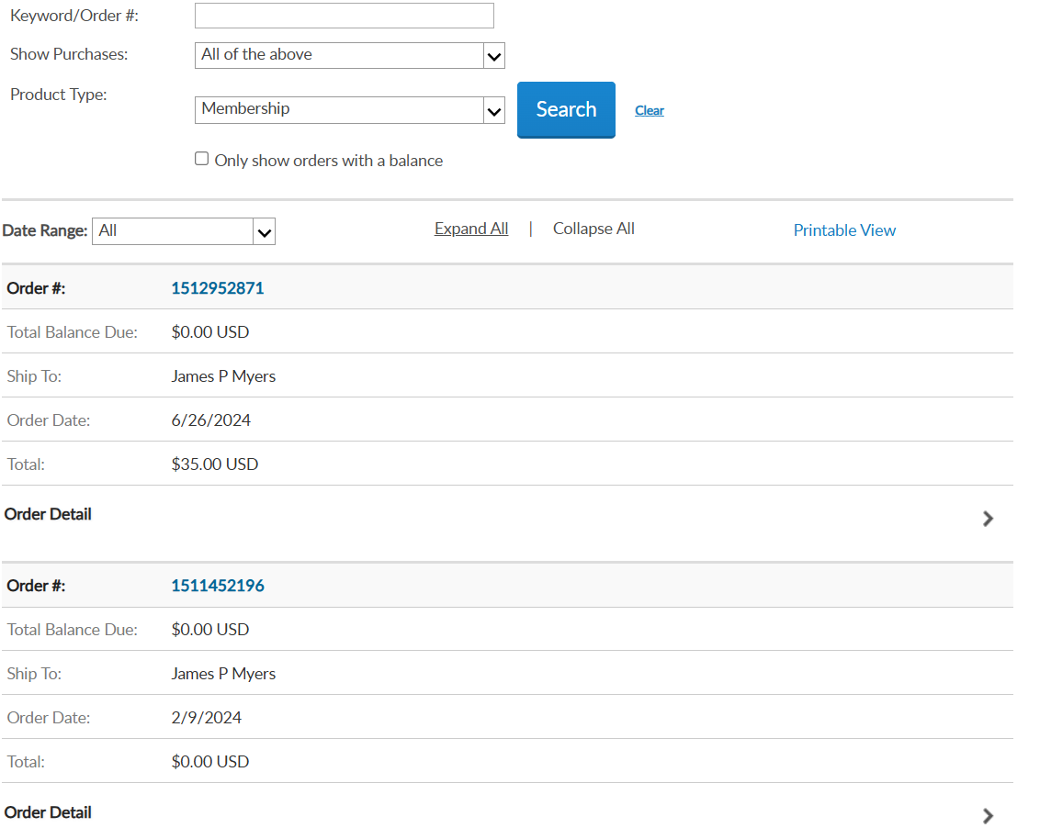

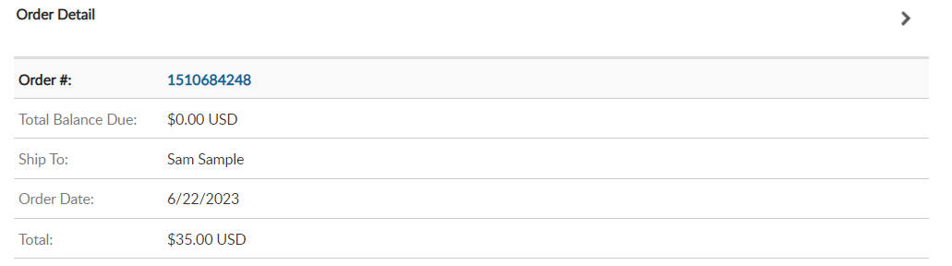
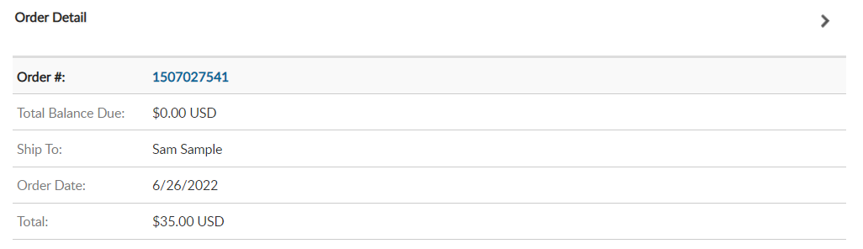
Sam Sample
6/23/2024
6/23/2024
Sam Sample
Notes:
Purchase history shows history of payments made for membership, donations and subscriptions listing the amount and date. <1> Use date range to view membership payments.

Slide 28
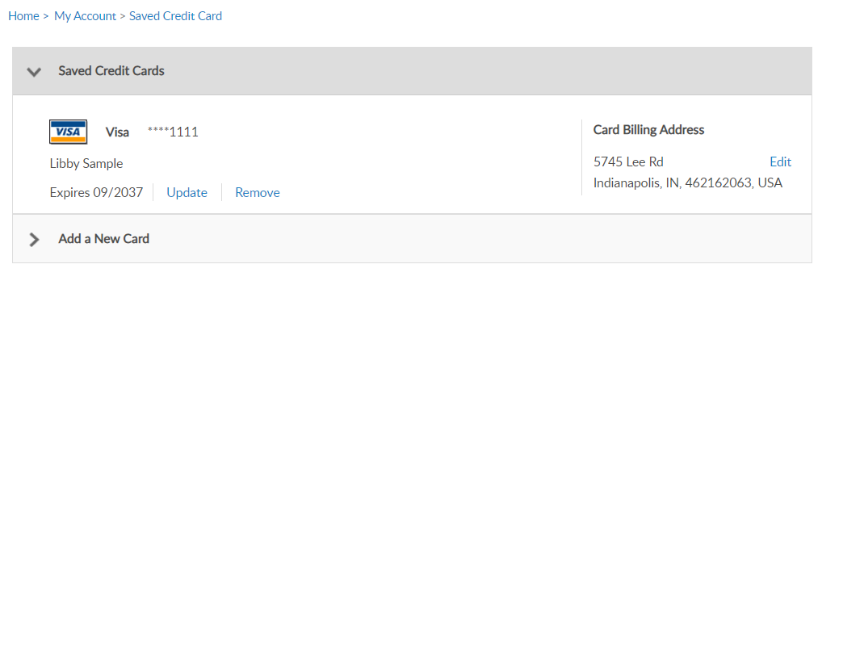
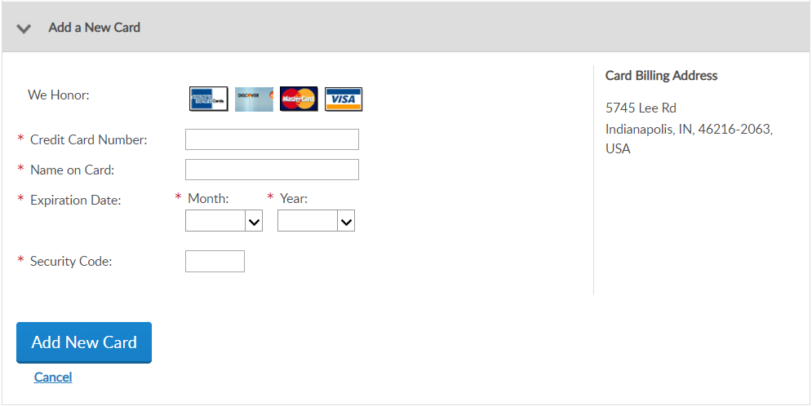
Notes:
Credit card information can be stored for future renewals and donations. To add, remove or update credit card information to go Saved Credit Cards.

Slide 29
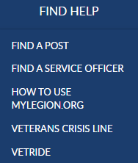
000123456789
PrimaryEmailAddress.com
000123456789
Notes:
Online help is available from the top Menu “Find Help”.
Step by step instructions, videos and training presentations will assist with how to manage your membership.

Slide 30
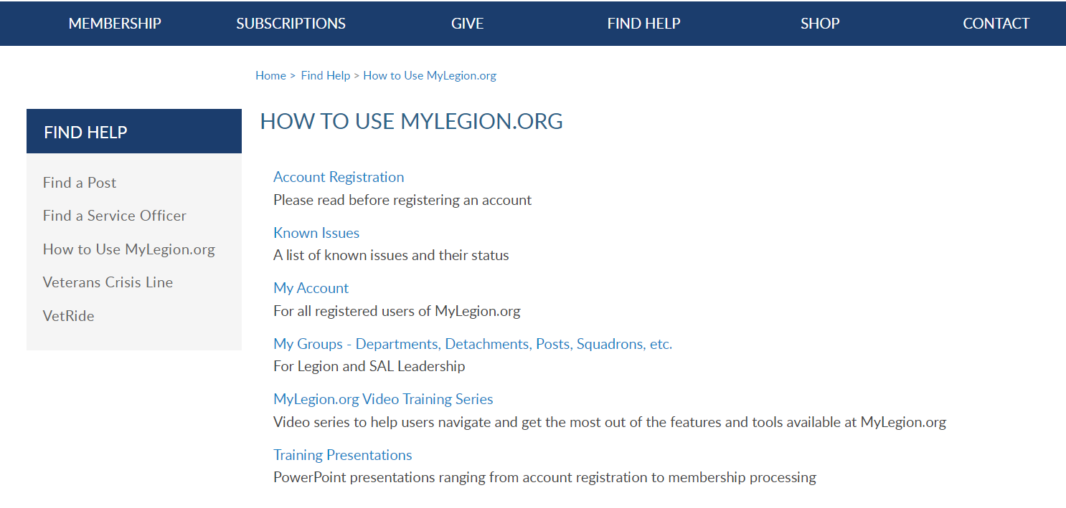
Online Help
Notes:
Step by step instructions, videos and training presentations will assist with how to manage groups in MyLegion. My Groups instructions include managing membership, online, membership processing, reports and all other administrative tasks.

Slide 31
MYLEGION SUPPORT
MyLegion@legion.org
833.253.9995
Monday – Friday
8:00am – 4:30pm
(Eastern)
The American Legion National HQs
5745 Lee Road
Indianapolis, IN 46216
Contact your MyLegion support team to assist with any questions or tools on your MyLegion account.
Notes:
Contact your myLegion support team to assist with questions and tools for MyLegion. Email mylegion@legion.org or call 833-253-9995 Monday through Friday.

